Slide 1
Organizational Behavior
Topic: Group Decision Making
Dr. C. Vijaya Banu
Associate Professor , School of Management
SASTRA Deemed University, Thanjavur – 613 401
vijayabanu@mba.sastra.edu

Slide 2
What is Decision-Making?
 Decision-making is the process whereby a final but best choice is made among the alternatives available.
 Group decision making (also known as collaborative decision making) is a situation faced when individuals collectively make a choice from the alternatives before them. This decision is no longer attributable to any single individual who is a member of the group.

Slide 3
Advantages of group participation in decision making
1. More information than individual.
2. Groups have a wider range of knowledge to draw on than does the individual.
3. Generate a great number of alternative.
4- Increase acceptance.
5. It may be less time consuming for a group to gather information and analyze it.
6. This may be no more expensive than having a higher-paid manager make the decision.
7- Understand the decision better.
8- Greater creativity.

Slide 4
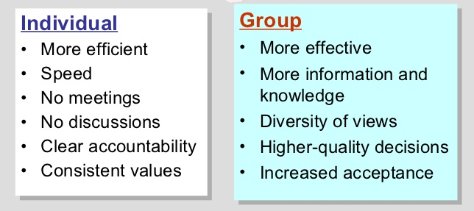
Differences

Slide 5
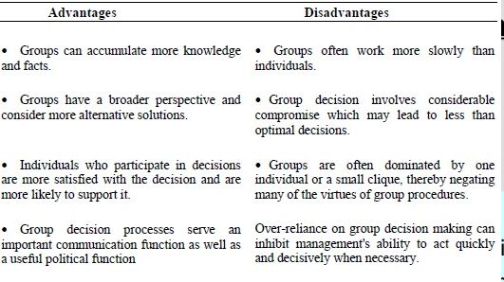
Advantages and disadvantages

Slide 6
How Do Groups Make Decisions?
 Group Size :Not too Large, nor too Small. The ideal size is 5 to 7 members for effective decision making.
 Group Composition :Higher status of some group members, in terms of background or expertise, influences the other group members opinions.
 Unanimity of Group Consensus : A united group exerts greater pressure to confirm than a group divided by dissension (disagreement).
 The Risky Shift : People tend to make more risky decision as a group, rather than as an individual.

Slide 7
Some Roles Commonly Played by Group Members
Task-Oriented Roles Relations-Oriented Roles Self-Oriented Roles
Initiator-Contributors Harmonizers Blockers
Recommend new-solutions to Mediate group conflicts Act stubborn and resistant to the group members group
Information Seekers Compromisers Recognition Seekers
Attempt to obtain the necessary Shift opinions to create Call attention to their own facts group harmony achievements
Opinion givers Encouragers Dominators
Share own opinion with others Praise and encourage others Assert by authority manipulating the group
Energizers Expediters Avoiders
Stimulate the group into action Suggest ways the groups Maintain distance, isolate whenever interest drops can operate more smoothly themselves from fellow group members

Slide 8
Techniques
Brainstorming
This technique involves a group of people, usually between five and ten, sitting around a table, generating ideas in the form of free association. The primary focus is on generation of ideas rather them on evaluation of ideas. Brainstorming technique is very effective when the problem is comparatively specific.
Nominal Group Technique (NGT)
Nominal group technique is similar to brainstorming except that the approach is more structured. Members form the group in name only and operate independently, generating ideas for solving the problem on their own, in silence and in writing. Members do not interact with each other so that strong personality domination is avoided. It encourages individual creativity.

Slide 9
Techniques
Delphi Technique:
This technique is the modification of the nominal group technique
1. The problem is identified and a sample of experts is selected. These experts are asked to provide potential solutions through a series of carefully designed questionnaires.
2. Each expert completes and returns the initial questionnaire.
3. The results of the questionnaire are compiled at a central location and the central coordinator prepares a second questionnaire based on the previous answers.
4. Each member receives a copy of the results along with the second questionnaire.
5. Members are asked to review the results and respond to second questionnaire. The results typically trigger new solutions or cause changes in the original position.
6. The process is repeated until a consensus is reached.

Slide 10
Techniques
Didactic interaction:
This technique is applicable only in certain situations, but is an excellent method when such a situation exists. The type of problem should be such that it results in a yes-no solution. For example, the decision may be to buy or not to buy, to merge or not to merge, to expand or not to expand and so on. Such a decision requires an extensive and exhaustive discussion and investigation since a wrong decision can have serious consequences.

Slide 11
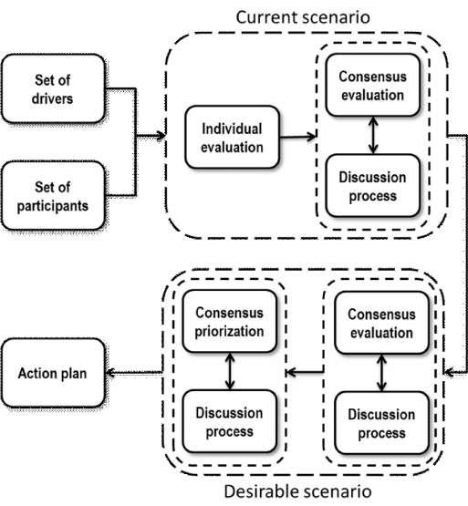
Consensus Mapping
Consensus mapping is a technique with the purpose of deriving a collective comprehension of problems by team members, in order for agreement regarding the activities required to reach a solution and their sequence to be unanimously understood. It is usual that ideas are brainstormed as the input to this exercise.
 Here, an attempt is made to arrive at a decision by pooling the ideas together generated by several task sub-groups.
 Process: It begins with developing ideas by a task sub-group. The facilitators encourage participants to further develop clusters of ideas.
The ideas so generated are developed & narrowed in smaller number of ideas.
They are consolidated into a representative structure called ‘strawman map’, Or Consensus Mapping which is further narrowed down to arrive at a mutually acceptable solution.

Slide 12
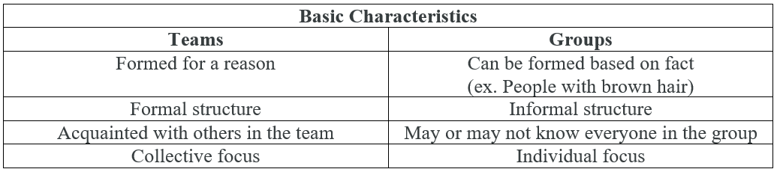
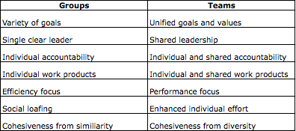
Differences

Slide 13
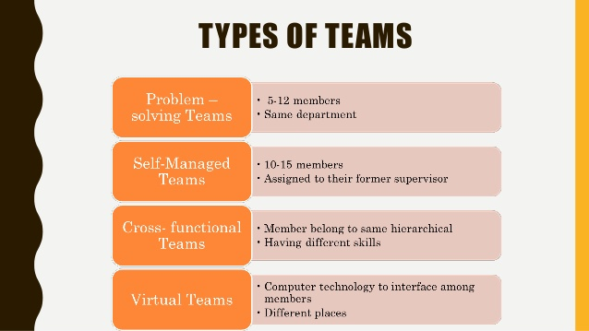

Slide 14
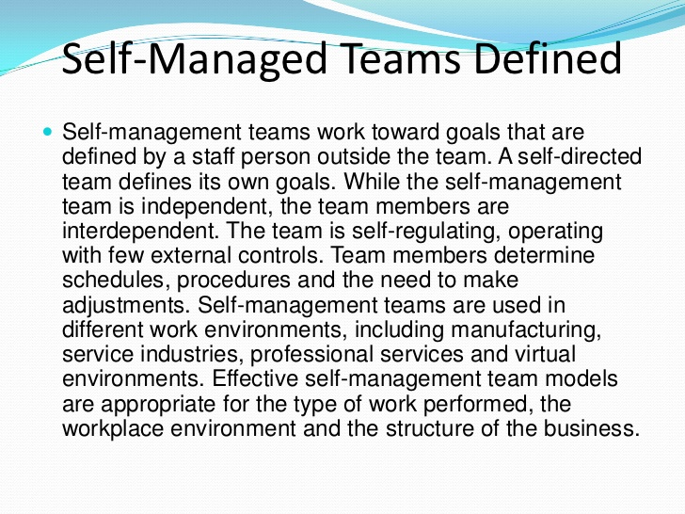

Slide 15
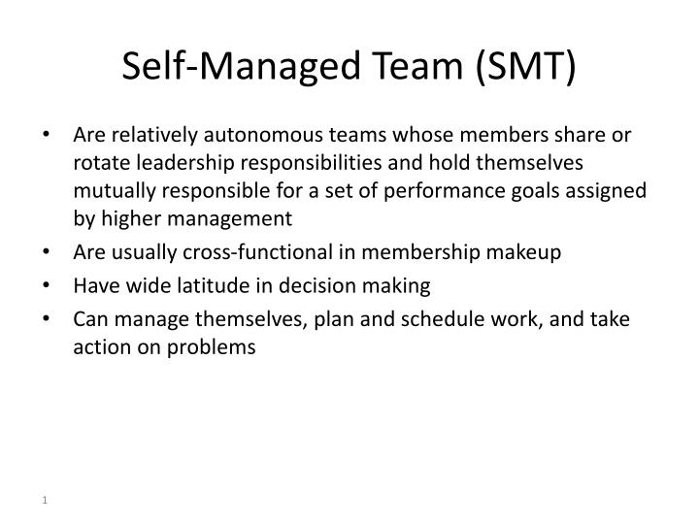

Slide 16
